Slide 1
CSC 455: Database Processing for Large-Scale Analytics
Aastha Gupta
Lecture 4
April 18, 2018

Slide 2
Objectives
Midterm Review
Identify the available group functions
Describe the use of group functions
Group data by using the GROUP BY clause
Include or exclude grouped rows by using the HAVING clause
CDM CSC 455 – Databases for Large Scale Analytics

Slide 3
Midterm
Next week, in-class
Online students, please register if you have not
(Up to) 2.5 hours, no textbook/calculators
A page of original notes (two sides)
Some True/False questions
One or two short-answer questions
CDM CSC 455 – Databases for Large Scale Analytics

Slide 4
SQL
Create a table
Insert/Delete/Update rows
Write a SELECT statement
Wild cards (i.e. LIKE)
Aggregates/Group By
Nested queries
JOINs (INNER and OUTER)
NULLs
CDM CSC 455 – Databases for Large Scale Analytics

Slide 5
SQL
Database integrity
Referential integrity
Foreign keys
Entity integrity
Primary keys
Domain constraints
General constraints
CDM CSC 455 – Databases for Large Scale Analytics

Slide 6
Relational Database Design
Update anomalies (modify/insert/delete)
Interpreting functional dependencies
First Normal Form
Second Normal Form
Third Normal Form
Decomposition/Testing normal forms
CDM CSC 455 – Databases for Large Scale Analytics

Slide 7
UPDATE
UPDATE Store SET city= ’Bohston’ WHERE city = ‘Boston’;
Updates Boston tuples to new spelling
UPDATE Store SET city= 'Boston' WHERE city LIKE 'B%ton';
Set “Boston” spelling
Includes “Boston”, “Bohston” and even “Brighton”

Slide 8
UPDATE
UPDATE Savings
SET Amount = Amount * 1.2
WHERE accountType = ‘CD’;
UPDATE Checking
SET Amount = Amount * 1.04
WHERE Amount > 50;

Slide 9
Boolean Operations
For single conditions use the immediate result
Can combine multiple conditions with boolean operators
AND
OR
NOT

Slide 10
AND Operator
Binary operator (2 inputs)
Condition1 AND Condition2
True if both Condition1 and Condition2 are true
( ( Condition3 AND Condition4 ) AND Condition5 )
Condition3_and_4 AND Condition5

Slide 11
OR Operator
Binary operator
Condition1 OR Condition2
True if either Condition1 or Condition2 is true
( ( Condition3 OR Condition4 ) OR Condition5 )
Condition3_or_4 OR Condition5

Slide 12
NOT Operator
Unary operator
Applies to single condition only
NOT Condition1
True if either Condition1 is false
NOT (NOT Condition2)
Equivalent to Condition2
True if Condition2 is true

Slide 13
Combining AND/OR/NOT
Condition grouping
(Cond1 OR Cond2) AND Cond3
Cond1 OR (Cond2 AND Cond3)
NOT is unary
Cond1 AND NOT Cond2
Cond1 AND (NOT Cond2)

Slide 14
ORDER BY
ORDER BY list of ordering attributes
Tuples returned by the query are sorted by the first attribute in the list
Ties are broken by the second attribute, then the third, et cetera
Tuples are sorted in ascending order unless we put DESC after an attribute
ORDER BY <column*> [ASC|DESC]

Slide 15
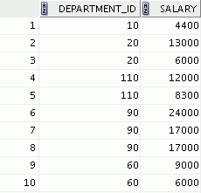


Group Functions
Group functions operate on sets of rows to give one result per group.
EMPLOYEES
Maximum salary in EMPLOYEES table
…

Slide 16
Types of Group Functions
AVG
COUNT
MAX
MIN
SUM
Group
functions

Slide 17
Group Functions: Syntax
SELECT group_function(column), ...
FROM table
[WHERE condition];

Slide 18
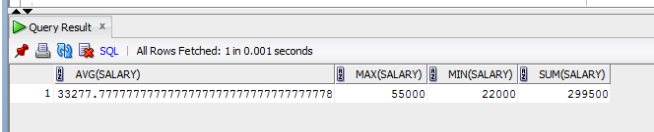
AVG and SUM Functions
You can use AVG and SUM for numeric data.
select AVG(salary), MAX(salary),
MIN(salary), SUM(salary)
FROM employee;

Slide 19
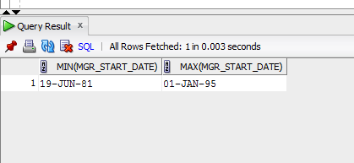
MIN and MAX Functions
You can use MIN and MAX for numeric, character, and date data types
select MIN(Mgr_start_date), MAX(Mgr_start_date)
FROM department;

Slide 20
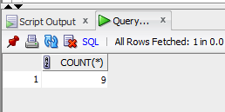
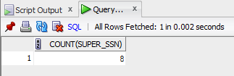
COUNT Function
COUNT(*) returns the number of rows in a table.
COUNT(expr) returns the number of rows with non-null values for expr:
select COUNT(*) from employee;
select COUNT(super_ssn) from
employee;

Slide 21
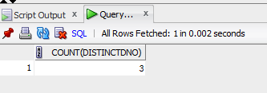
COUNT With DISTINCT
COUNT(DISTINCT expr) returns the number of distinct non-null values of expr.
To display the number of distinct department values in the EMPLOYEES table:
select COUNT(DISTINCT DNO) from
employee;

Slide 22

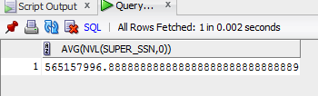
Group Functions and Null Values
Group functions ignore null values in the column
select AVG(super_ssn)
from employee;
select AVG(NVL(super_ssn,0))
from employee;

Slide 23
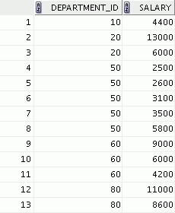
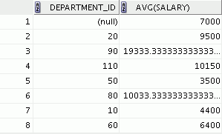

Creating Groups of Data
EMPLOYEES
Average salary in the
EMPLOYEES table for
each department
4400
9500
3500
6400
10033
…

Slide 24
GROUP BY Clause Syntax
You can divide rows in a table into smaller groups by using the GROUP BY clause.
SELECT column, group_function(column)
FROM table
[WHERE condition]
[GROUP BY group_by_expression]
[ORDER BY column];

Slide 25
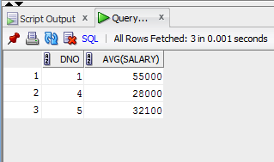
GROUP BY Clause
All the columns in the SELECT list that are not in group functions must be in the GROUP BY clause.
select dno,AVG(salary)
from employee
GROUP BY dno;

Slide 26
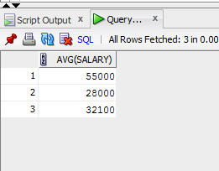
GROUP BY Clause
All the columns in the SELECT list that are not in group functions must be in the GROUP BY clause.
Select AVG(salary)
from employee
GROUP BY dno;

Slide 27
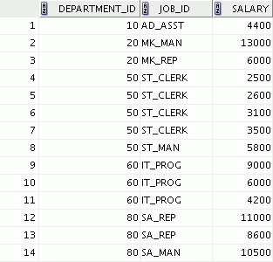
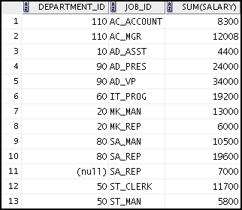

Grouping by More Than One Column
EMPLOYEES
Add the salaries in the EMPLOYEES
table for each job, grouped by department.
…

Slide 28
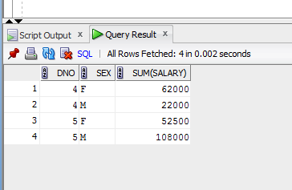
GROUP BY Clause on Multiple Columns
select dno,sex ,SUM(salary) from employee
where dno > 1
GROUP BY dno, sex
ORDER BY dno;

Slide 29
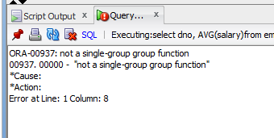
Illegal Queries Using Group Functions
Any column or expression in the SELECT list that is not an aggregate function must be in the GROUP BY clause:
select dno, AVG(salary)
from employee;

Slide 30
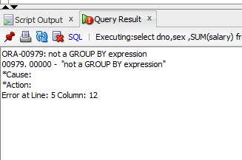
Illegal Queries Using Group Functions
select dno,sex ,SUM(salary) from employee
where dno > 1
GROUP BY dno
ORDER BY dno;

Slide 31
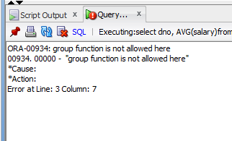
Illegal Queries Using Group Functions
You cannot use the WHERE clause to restrict groups.
You use the HAVING clause to restrict groups.
You cannot use group functions in the WHERE clause
select dno, AVG(salary)
from employee
WHERE AVG(salary) > 20000
GROUP BY dno;

Slide 32
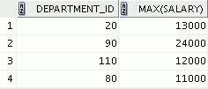
Restricting Group Results
EMPLOYEES
The maximum salary per department when it is
greater than $20,000

Slide 33
Restricting Group Results with the HAVING Clause
When you use the HAVING clause, the Oracle server restricts groups as follows:
Rows are grouped.
The group function is applied.
Groups matching the HAVING clause are displayed.
SELECT column, group_function
FROM table
[WHERE condition]
[GROUP BY group_by_expression]
[HAVING group_condition]
[ORDER BY column];

Slide 34
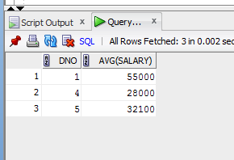
HAVING Clause
select dno, AVG(salary)
from employee
GROUP BY dno
HAVING AVG(salary) > 20000;

Slide 35
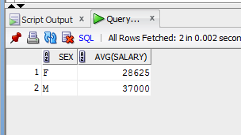
HAVING Clause
select sex, AVG(salary)
from employee
GROUP BY sex
HAVING SUM(salary) > 20000
ORDER BY SUM(salary);

Slide 36
Order of Operations
In what order are these clauses applied?
FROM: Chooses a table
WHERE: Chooses a set of tuples
GROUP BY: Partitions them into groups
HAVING: Chooses some subset of the groups
SELECT: Chooses what columns to display
ORDER BY: Chooses the order to display them

Slide 37
Quiz
Identify the two guidelines for group functions and the GROUP BY clause.
You cannot use a column alias in the GROUP BY clause.
The GROUP BY column must be in the SELECT clause.
By using a WHERE clause, you can exclude rows before dividing them into groups.
The GROUP BY clause groups rows and ensures order of the result set.
If you include a group function in a SELECT clause, you must include a GROUP BY clause.

Slide 38
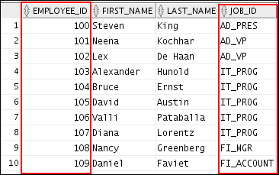
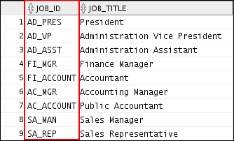
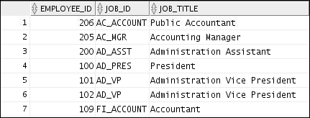
Obtaining Data from Multiple Tables
EMPLOYEES
JOBS
…

Slide 39
Obtaining Data from Multiple Tables
Data that is distributed among different tables can be combined into a single set of tuples using different types of joins:
Equi-join
Natural join
Inner join
Outer join (left, right, full)

Slide 40
Table/Column Alias
Rename a table or a column temporarily by giving another name.
Table Aliases are used during SQL joins.
SELECT column1, column2....
FROM table_name AS alias_name
WHERE [condition];

Slide 41
Cartesian Products
Cartesian product is a join of every row of one table to every row of another table.
A Cartesian product generates a large number of rows and the result is rarely useful.
CDM CSC 455 – Databases for Large Scale Analytics

Slide 42
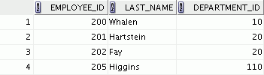
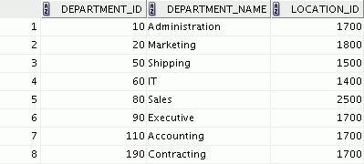




Generating a Cartesian Product
EMPLOYEES (20 rows)
DEPARTMENTS (8 rows)
…
Cartesian product: 20 x 8 = 160 rows
CDM CSC 455 – Databases for Large Scale Analytics

Slide 43
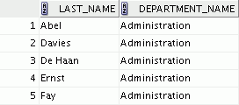

Creating Cross Joins
A CROSS JOIN is a JOIN operation that produces the Cartesian product of two tables.
To create a Cartesian product, specify the CROSS JOIN in your SELECT statement.
SELECT last_name, department_name
FROM employees
CROSS JOIN departments ;
…
CDM CSC 455 – Databases for Large Scale Analytics

Slide 44
Equi-Join
An equi-join keeps only those rows where the two combined rows agree on the shared attribute(s):
SELECT …
FROM TABLE1, TABLE2 WHERE TABLE1.Attribute = TABLE2.Attribute;
CDM CSC 455 – Databases for Large Scale Analytics

Slide 45
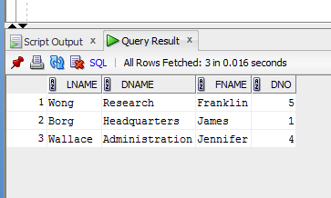
Equi-Join
An equi-join uses the equal sign as the comparison operator.
select Lname,Dname, Fname, Dno
FROM employee,department
WHERE department.mgr_ssn = employee.SSn;
CDM CSC 455 – Databases for Large Scale Analytics

Slide 46
Natural Joins
The NATURAL JOIN clause is based on all the columns that have the same name in two tables.
It selects rows from the two tables that have equal values in all matched columns.
The same names columns of the associated table are returned only once
If the columns having the same names have different data types, an error is returned.
SELECT * FROM table1 NATURAL JOIN table2;
CDM CSC 455 – Databases for Large Scale Analytics

Slide 47
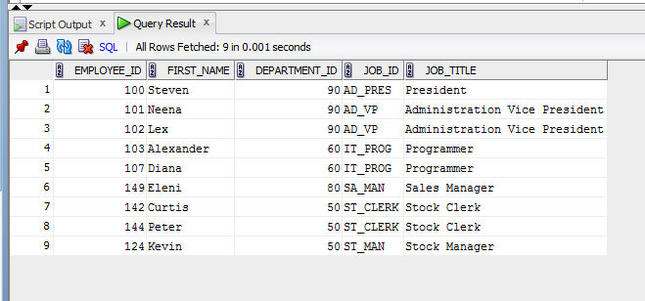
Retrieving Records with Natural Joins
SELECT employee_id, first_name, job_id, job_title
from employees NATURAL JOIN jobs;
CDM CSC 455 – Databases for Large Scale Analytics

Slide 48
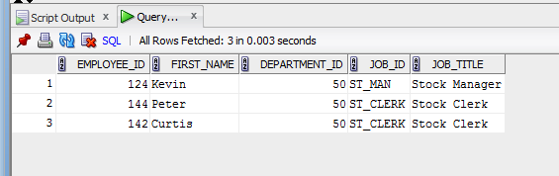
Retrieving Records with Natural Joins
SELECT employee_id, first_name,department_id,
job_id, job_title
from employees NATURAL JOIN jobs
where department_id = 50;
CDM CSC 455 – Databases for Large Scale Analytics

Slide 49
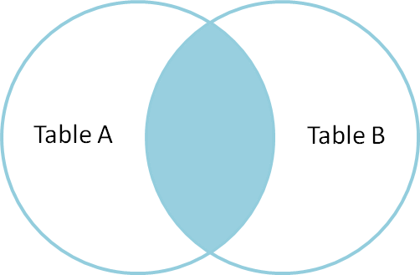
INNER Joins
The join of two tables returning only matched rows is called an INNER join.
The inner joins enables a maximum of 256 tables that can be joined at the same time.
CDM CSC 455 – Databases for Large Scale Analytics

Slide 50
Inner Join Syntax
SELECT table1.column1,table1.column2,table1.column3,
table2.column1,table2.column2,table2.column3…
FROM table 1
INNER JOIN table2
ON table1.column_name = table2.column_name;
CDM CSC 455 – Databases for Large Scale Analytics

Slide 51
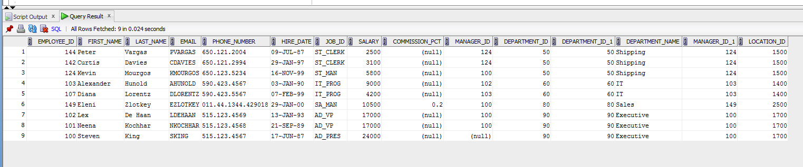
Inner Join
select * from employees e
INNER JOIN departments d
ON e.department_id = d.department_id;
CDM CSC 455 – Databases for Large Scale Analytics

Slide 52
INNER Versus OUTER Joins
In SQL:1999, the join of two tables returning only matched rows is called an INNER join.
A join between two tables that returns the results of the INNER join as well as the unmatched rows from the left (or right) table is called a left (or right) OUTER join.
A join between two tables that returns the results of an INNER join as well as the results of a left and right join is a full OUTER join.
CDM CSC 455 – Databases for Large Scale Analytics

Slide 53
OUTER Joins
The join of two tables returning all matched rows and non matching rows from one or both tables.
The outer join can be performed on only 2 tables at a time.
Three types of outer join
Left Outer Join
Full Outer Join
Right Outer Join
CDM CSC 455 – Databases for Large Scale Analytics

Slide 54
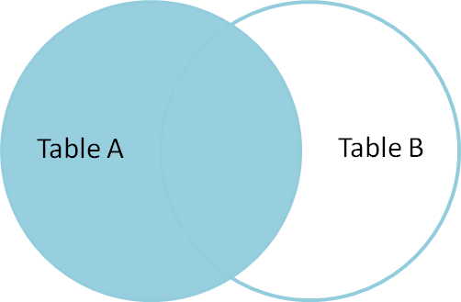
LEFT OUTER JOIN
Left joins include all rows from the first (left) table, even if there are no matching rows in the second (right) table.
CDM CSC 455 – Databases for Large Scale Analytics

Slide 55
LEFT OUTER JOIN SYNTAX
SELECT *
FROM table1
LEFT [ OUTER ] JOIN table2
ON table1.column_name=table2.column_name;
CDM CSC 455 – Databases for Large Scale Analytics

Slide 56
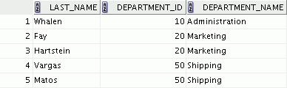
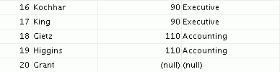
LEFT OUTER JOIN
SELECT e.last_name, e.department_id, d.department_name
FROM employees e LEFT OUTER JOIN departments d
ON (e.department_id = d.department_id) ;
…
CDM CSC 455 – Databases for Large Scale Analytics

Slide 57
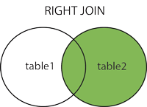
RIGHT OUTER JOIN
Right joins include all rows from the second (right) table, even if there are no matching rows in the first (left) table.
CDM CSC 455 – Databases for Large Scale Analytics

Slide 58
RIGHT OUTER JOIN SYNTAX
SELECT *
FROM table1
RIGHT [ OUTER ] JOIN table2
ON table1.column_name=table2.column_name;
CDM CSC 455 – Databases for Large Scale Analytics

Slide 59
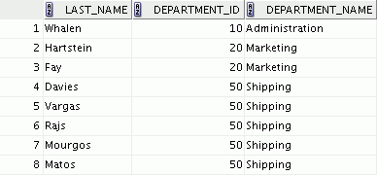

RIGHT OUTER JOIN
SELECT e.last_name, d.department_id, d.department_name
FROM employees e RIGHT OUTER JOIN departments d
ON (e.department_id = d.department_id) ;
…
CDM CSC 455 – Databases for Large Scale Analytics

Slide 60
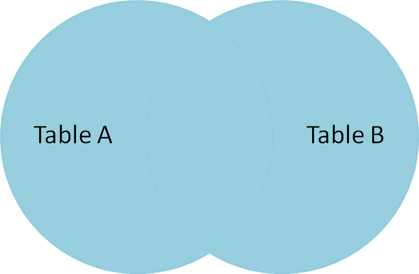
FULL OUTER JOIN
Select all records from left (first) table and right (second) table, regardless of whether the join condition is met or not.
CDM CSC 455 – Databases for Large Scale Analytics

Slide 61
FULL OUTER JOIN SYNTAX
SELECT *
FROM table1
FULL OUTER JOIN table2
ON table1.column_name=table2.column_name;
CDM CSC 455 – Databases for Large Scale Analytics

Slide 62
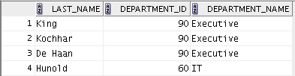
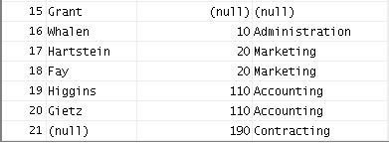
FULL OUTER JOIN
SELECT e.last_name, d.department_id, d.department_name
FROM employees e FULL OUTER JOIN departments d
ON (e.department_id = d.department_id) ;
…
CDM CSC 455 – Databases for Large Scale Analytics

Slide 63
Qualifying Ambiguous Column Names
Use table prefixes to qualify column names that are in multiple tables.
Instead of full table name prefixes, use table aliases.
Table alias gives a table a shorter name:
Keeps SQL code smaller, uses less memory
Use column aliases to distinguish columns that have identical names, but reside in different tables.
CDM CSC 455 – Databases for Large Scale Analytics

Slide 64
Applying Additional Conditions to a Join
Use the AND clause or the WHERE clause to apply additional conditions:
SELECT e.employee_id, e.last_name, e.department_id,
d.department_id, d.location_id
FROM employees e JOIN departments d
ON (e.department_id = d.department_id)
AND e.manager_id = 149 ;
Or
SELECT e.employee_id, e.last_name, e.department_id,
d.department_id, d.location_id
FROM employees e JOIN departments d
ON (e.department_id = d.department_id)
WHERE e.manager_id = 149 ;
CDM CSC 455 – Databases for Large Scale Analytics

Slide 65
Non-Equi-Join
An sql join condition that uses some other comparison operator other than the equal sign like >, <, >=, <=
CDM CSC 455 – Databases for Large Scale Analytics

Slide 66
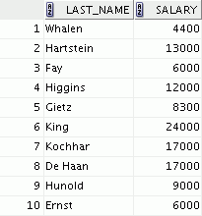
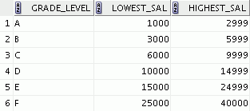

Nonequijoins
EMPLOYEES
JOB_GRADES
The JOB_GRADES table defines the LOWEST_SAL and HIGHEST_SAL range of values for each GRADE_LEVEL. Therefore, the GRADE_LEVEL column can be used to assign grades to each employee.
…
CDM CSC 455 – Databases for Large Scale Analytics

Slide 67
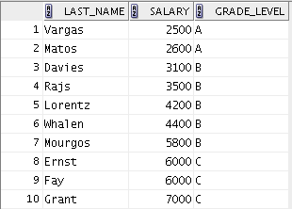
Retrieving Records with Nonequijoins
SELECT e.last_name, e.salary, j.grade_level
FROM employees e JOIN job_grades j
ON e.salary
BETWEEN j.lowest_sal AND j.highest_sal;
…
CDM CSC 455 – Databases for Large Scale Analytics

Slide 68
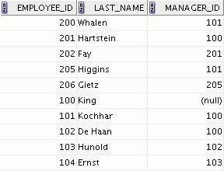
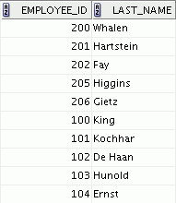
Self-Joins
EMPLOYEES (WORKER)
EMPLOYEES (MANAGER)
…
CDM CSC 455 – Databases for Large Scale Analytics

Slide 69
Self-Joins
Joins the table to itself
SELECT …
TABLE1 as Alias1, TABLE as Alias2 ON Alias1.AttributeA = Alias2.AttributeB;
CDM CSC 455 – Databases for Large Scale Analytics

Slide 70
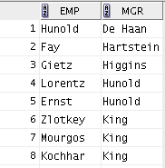
Self-Joins
Joins the table to itself
SELECT worker.last_name emp, manager.last_name mgr
FROM employees worker JOIN employees manager
ON (worker.manager_id = manager.employee_id);
CDM CSC 455 – Databases for Large Scale Analytics

Slide 71
Next Class
Next Class
More SQL
Nested Queries
Date Conversion
Python SQLite
Python I/0

